Slide 1
Extended gateway model for OPC UA/IoT device integration
Peter Peniak, Emília Bubeníková, Alžbeta Kanáliková
Department of Control and Information Systems,
Faculty of Electrical Engineering and Information Technology
University of Žilina
IEEE 19th World Symposium on Applied Machine Intelligence and Informatics (SAMI 2021)
January 21-23, 2021 in Herl'any, Slovakia.

Slide 2
Content
Introduction
OPC UA
IoT protocols
Model of OPC UA/IoT extended gateway
Validation of OPC UA/IoT extended gateway
Conclusion
SAMI 2021, January 21-23, 2021 in Herl'any, Slovakia

Slide 3
Introduction
Open communication of all devices (IoT devices, PLCs, Cobots...) is enabler for Industry 4.0
IoT devices support dedicated protocols due to their contrains and limitations (e.g. battery)
OPC UA is defacto standard for communication of applications (MES) and industrial systems(PLCs,...)
Integration gateway is needed in order to enable communication via different protocols
Our main task was to design integration OPC/IoT gateway with
  OPC UA as an integration backbone (services, data model, Companion specification)
  Common gateway model for all protocols and OPC UA
  and
  implement and validate the proposed model in laboratory (ASP.NET, Rabbit MQ).
SAMI 2021, January 21-23, 2021 in Herl'any, Slovakia

Slide 4
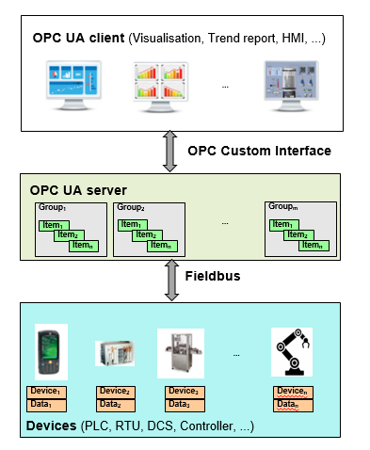
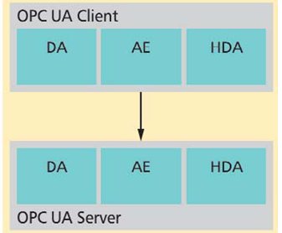
I. OPC UA(1)

Slide 5
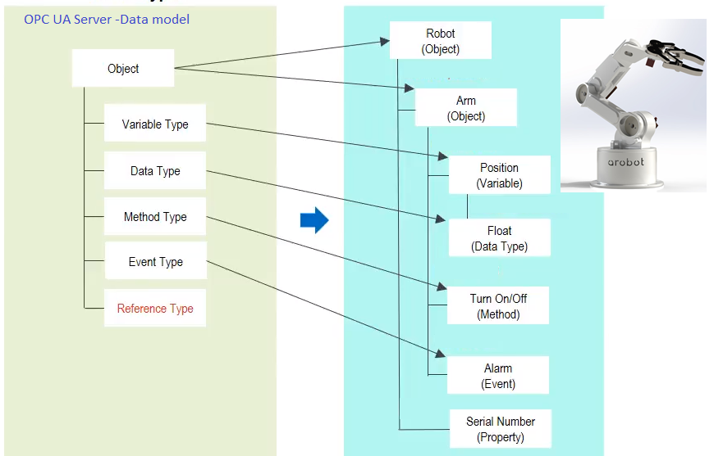
I. OPC UA(2)
SAMI 2021, January 21-23, 2021 in Herl'any, Slovakia

Slide 6
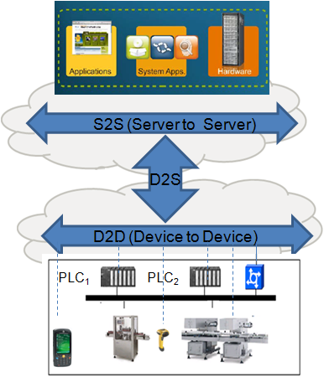
II. IoT(1) – Application protocols
 | IoT protocols
 | Protocol | Class | Transport
MQTT | Message Queue Telemetry Transport | M2S | TCP
DDS | Data Distribution Service | M2M | UDP
CoAP | Constrained Application Protocol | M2S M2M | UDP
AMQP | Advanced Message Queuing Protocol | M2S | TCP
SOAP/REST | Service Oriented Architecture Protocol | S2S | TCP
SAMI 2021, January 21-23, 2021 in Herl'any, Slovakia

Slide 7
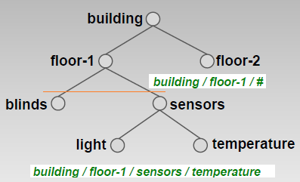

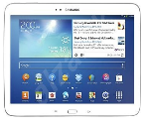
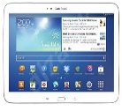
II. IoT(2) - MQTT
MQTT client
(Publisher)
MQTT server
(Broker)
MQTT client
(Subscriber)
Topic_x ₁
Topic_x ₂
Topic_x _{n}
1 -CONNECT
2 -CONNACK
3 -PUBLISH
1 -CONNECT
2 -PUBACK
2 -CONNACK
8 -SUBSCRIBE
9 -SUBACK
10 -UNSUBSCRIBE
11 -UNSUBACK
14 -DISCONNECT
SAMI 2021, January 21-23, 2021 in Herl'any, Slovakia

Slide 8
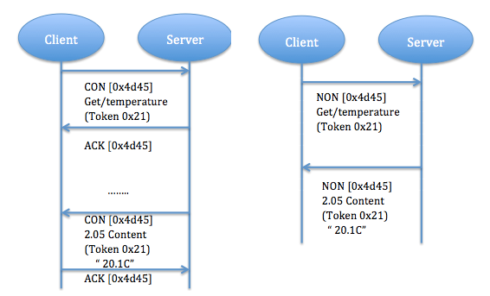
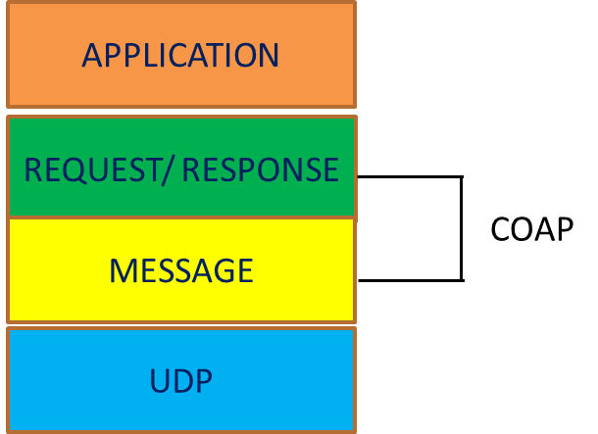
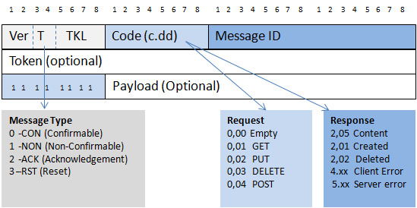
II. IoT(3) - CoAP
SAMI 2021, January 21-23, 2021 in Herl'any, Slovakia

Slide 9
III. Model of OPC UA/IoT gateway (1)
Internet (M2S, S2S – Cloud/hosts)
Outward interface
Y₁
Y₂
Y₃
OPC UA/IoT Gateway
Gateway Kernel
OPC UA
MQTT Broker
CoaAP Server
Mapping table
X₁₁
X₁₂
X_{1n}
X₂₁
X₂₂
X_{2m}
X₃₁
X₃₂
X_{3m}
Inward interface
N_{1i} - OPC device
N_{2i} - MQTT device
N_{3i} - CoAP device
X_{1j} - OPC message
X_{2j} - MQTT message
X_{3j} - CoAP message
N₁₁(OPC)
N₂₁(MQTT)
N₃₁(CoAP)
N₁₂(OPC)
N₂₂(MQTT)
N₃₂(CoAP)
N_{1n}(OPC)
N_{2m}(MQTT)
N_{3m}(CoAP)
Partition-I
Partition-II
Partition-J
SAMI 2021, January 21-23, 2021 in Herl'any, Slovakia

Slide 10
III. Model of OPC UA/IoT gateway (2)
Reference
CoAP server
OPC UA Server - AddressSpace
MQTT Broker -Topics
Item₁
Event
Method
/O₁/Topic₁
Variable Item₁
Object
O₁
Reference
Data type Integer
Item₂
Event
Method
/O₁ /O₁₁ /Topic₂
_{ROOT}
Variable Item₂
Object
O₁₁
Data type
.....
Reference
Item_{m}
Event
Method
Data type
/O_{n}/Topic_{m}
Object
O_{n}
Variable Item_{m}
SAMI 2021, January 21-23, 2021 in Herl'any, Slovakia

Slide 11
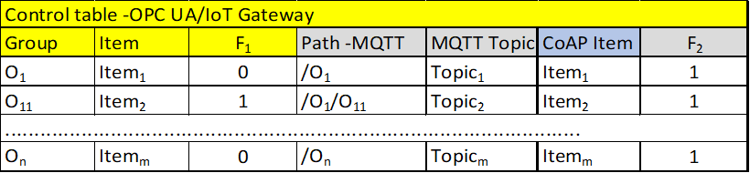
III. Model of OPC UA/IoT gateway (3)
Topic_{i} ~ F₁(O_{j}, Item_{i}, Path_{j}) (1) Topic_{i} - MQTT Topic from IoT devices (N_{2j})
Item_{i} ~ F₂(Path_{j,} Topic_{i}, O_{j}) (2) Item_{i} - OPC Item/CoAP Item
Path_{j} ~ /O_{x} /…/O_{j} (3) Path_{j} - MQTT folder structure (Topics)
Y₁ ~ {Item₁, Item_{2,} ..., Item_{m}} (4) Y₁- OPC server -DA (read/write -Items)
Y₂ ~ {Topic₁, Topic₂, ..., Topic_{m}} (5) Y₂- MQTT broker (publish/subscribe- Topics)
Y₃ ~ {Item₁, Item₂, ..., Itemc_{m}} (6) Y₃- CoAP server (GET/PUT Items)
where
O_{j} - OPC object/group in Address spac
F₁ - mapping of OPC Items to MQTT/CoAP
F₂ - mapping of MQTT Topics/CoAP Items to OPC
SAMI 2021, January 21-23, 2021 in Herl'any, Slovakia

Slide 12
III. Model of OPC UA/IoT gateway (4)
A) MQTT/CoAP → OPC UA
OPC UA/MQTT Gateway
Gateway kernel
1
OPC Client
MQTT Client
Control
table
4
2
CoAP client
3
3
OPC UA Server
MQTT Broker
CoAP Server
1) Import Topics/Items
5 (X₁₁)
3a (X₂₁)
3b (X₃₁)
2) Subscribe Topics
3a) Publish Topic_{i} (X₂₁)
3b) POST Item_{i} (X₃₁)
N₁₁(OPC)
N₂₁(MQTT)
N₃₁(CoAP)
4) Write to Item _{i}
5) Read Item _{i} (X₁₁)
SAMI 2021, January 21-23, 2021 in Herl'any, Slovakia

Slide 13
III. Model of OPC UA/IoT gateway (5)
B) OPC UA → MQTT/CoAP
OPC UA/MQTT Gateway
Gateway kernel
1
Control
table
OPC Client
MQTT Client
CoAP Client
3
4
6
OPC UA Server
MQTT Broker
CoAP Server
1) Import Topics/Items
2 (X₁₁)
5 (X₂₁)
7 (X₃₁)
2) Write to Item_{i} (X₁₁)
3) Read Item_{i}
4) MQTT Publish to Topic _{i}
N₁₁(OPC)
N₂₁(MQTT)
N₃₁(CoAP)
5) MQTT Subscribe Topic _{i} (X₂₁)
6) CoAP POST Item _{i}
7) CoAP GET Item _{i} (X₃₁)
SAMI 2021, January 21-23, 2021 in Herl'any, Slovakia

Slide 14
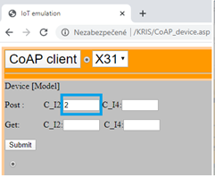
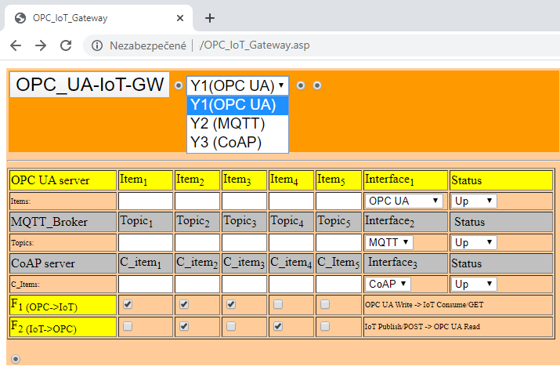
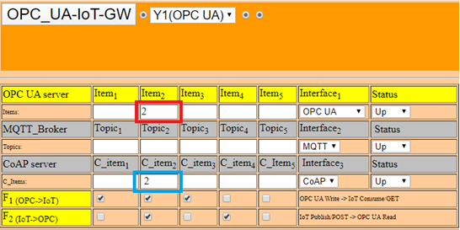
IV. Validation of OPC UA/IoT gateway (1)
SAMI 2021, January 21-23, 2021 in Herl'any, Slovakia

Slide 15
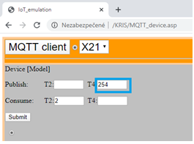
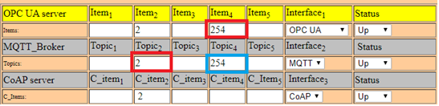
IV. Validation of OPC UA/IoT gateway(2)
SAMI 2021, January 21-23, 2021 in Herl'any, Slovakia

Slide 16
Conclusion
The proposed gateway includes an internal OPC server, MQTT broker and CoAP server. OPC and MQTT/CoAP communication are enabled in both directions by gateway software (Kernel) with assigned OPC UA , MQTT and CoAP clients.
The model of gateway is based on OPC UA Data model which was mapped to corresponding MQTT Topics and CoAP items. The configuration is defined by control table with mapping functions according to our numerical model (F1,F2).
The gateway functions have been validated in testing conditions for simple OPC UA –DA (TOP OPC server) configuration and MQTT broker (Rapid MQ). GUI was based on ASP.NET/HTML5.
The results confirmed expected capabilities, such as a mapping of Items to Topics and possibility for flexible gateway configuration.
There is a possibility to create advanced gateway model and extend its capabilities in order to support of all OPC services (DA, AE, HDA). As well, additional IoT application protocols can be integrated into gateway model, such as DDS.
SAMI 2021, January 21-23, 2021 in Herl'any, Slovakia

